Slide 1
Modelling Customer Churn for Internet Service Provider

Slide 2
Introduction
Definitions and Business Overview
Internet Service Providers (ISPs) are companies or organizations that provide individuals and businesses with access to the internet and related services through Connections such as Wireless, Satelite and Fibre Optic Cables. There main services are;
Internet Access Provision – Connecting users to the global internet.
Web Hosting – Hosting websites and email services.
Network Maintenance – Ensuring infrastructure is up and running with minimal downtime.
Customer churn (also known as customer attrition) is the rate at which customers stop doing business with a company over a given period. It’s a key metric for evaluating customer retention and overall business health, especially in subscription-based or service-oriented industries such as ISPs.

Slide 3
Problem Statement
Internet Providers significantly face competition from their peers and thus the need to track and model customer churn to establish churn probability and customers who are likely to churn.
Customer churn significantly impacts revenue and customer lifetime value.
Retaining existing customers is more cost-effective than acquiring new ones. However, identifying which customers are likely to churn remains a challenge.
This project aims to develop a predictive machine learning model to estimate churn risk scores and identify high-risk customers using a mix of behavioral, demographic, and feedback data.

Slide 4
Research Objectives
To build a supervised machine learning model capable of predicting customer churn risk using behavioral, transactional, and feedback data.
To Identify customer segments that are most likely to churn?
What are the top behavioral or demographic predictors of churn?
(iv) To recommend actionable customer retention strategies to mitigate customer churn.

Slide 5
Research Methodology
Business Understanding – Involved setting Business Objectives, assessing the situation, Determining data mining goals, and Project plan Preparation.
Data Understanding – Secondary dataset was obtained from Kaggle. The selected dataset contained
Data Preparation - Data cleaning & Data Pre-processing
Modelling – Random Forest, Decision Trees, Xgboost , and Neural Network.
(iv) Evaluation – Reviewing existing models to determine the best model for deployment
(V) Deployment

Slide 6
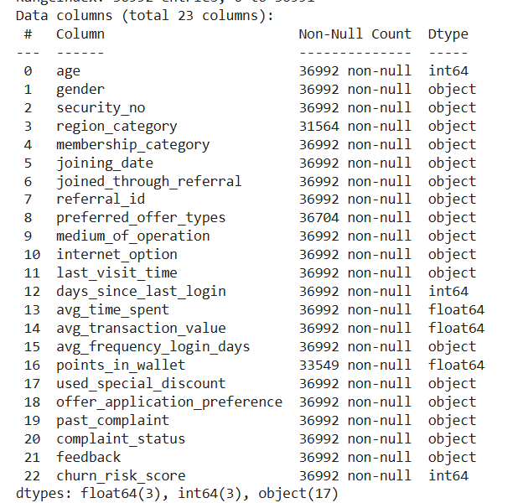
Data Understanding
The selected dataset contained 36,992 rows and 23 Columns. Churn risk score was the dependent variable while the various demographic, transactional and feedback variables formed the independent variables.

Slide 7
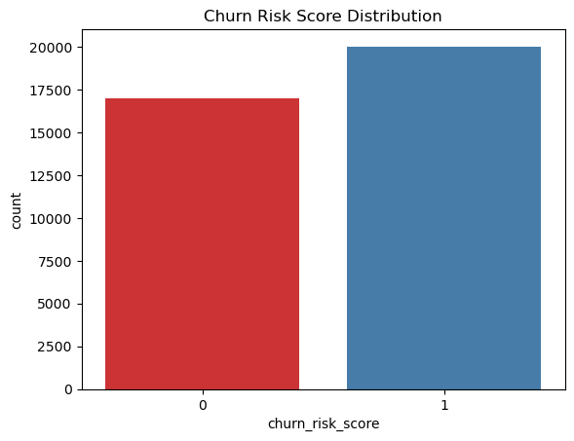
Data Understanding
The chart above indicates that the number of customers who are likely to churn and more customers who are unlikely to churn.

Slide 8
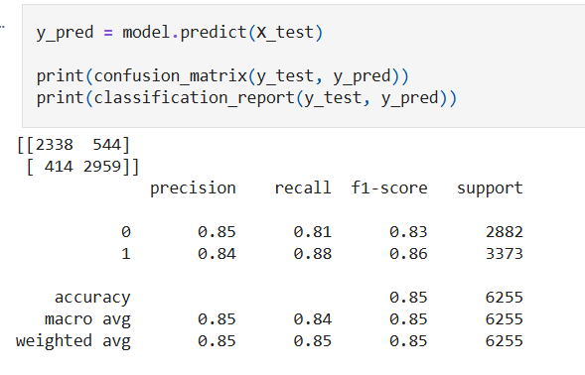
Modelling
Logistic regression, random forest, XG boost and light GBM were selected because they work best on a binary data(Churn risk).
(i)Logistic Regression- Selected as the baseline model.

Slide 9
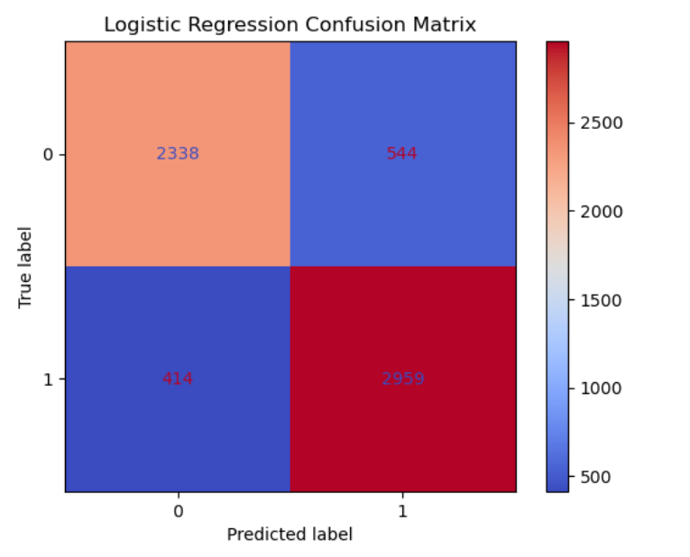

Slide 10
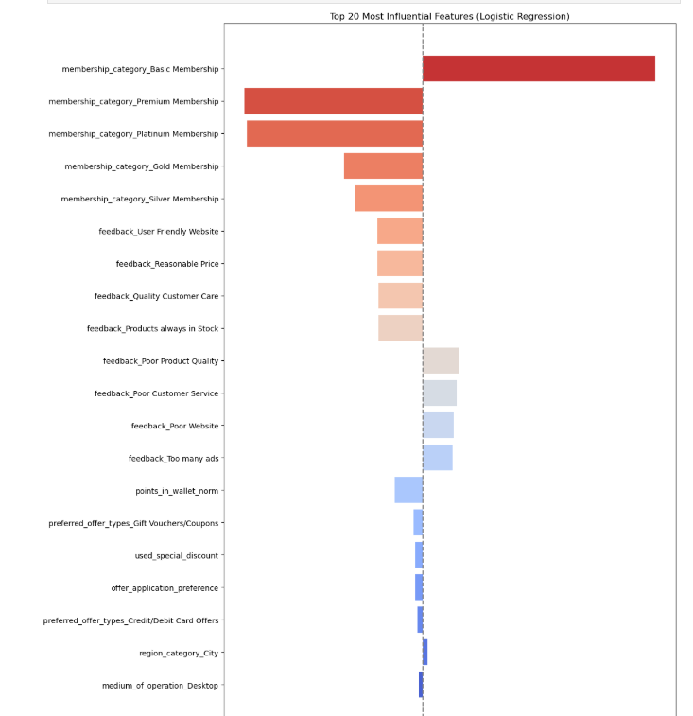

Slide 11
Logistic Regression Findings
The confusion matrix shows that the logistic regression model performs reliably in predicting customer churn risk. Out of 6,255 test samples, it correctly identified 2,342 low-risk (true negatives) and 2,929 high-risk customers (true positives), while misclassifying 540 low-risk as high-risk (false positives) and 444 high-risk as low-risk (false negatives).
The precision for both classes is 0.84, meaning the model is accurate 84% of the time when it makes a prediction.
Recall is 0.81 for low-risk and 0.87 for high-risk customers, showing the model is especially good at identifying actual churners.
F1-scores of 0.83 for low-risk and 0.86 for high-risk, there's a solid balance between precision and recall.
Overall, the model has accuracy of 84%, and the macro and weighted averages confirm consistent performance across both classes. This makes the model a strong and balanced tool for identifying churn risk in customers.

Slide 12
Random Forest Model
Random Forest captures more complex patterns in the data as it Handles both numerical and categorical data without scaling, captures non-linear relationships that Logistic Regression might miss.
Reduces overfitting by averaging multiple decision trees.
Provides feature importance to identify key churn indicators.
The model strikes a balance between performance and interpretability

Slide 13
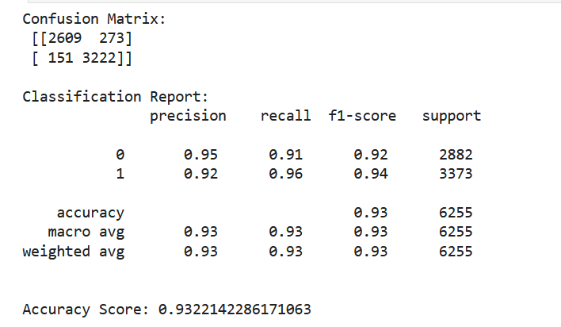

Random Forest Output
The Random Forest Classifier has demonstrated strong performance in predicting customer churn risk, achieving an overall accuracy of approximately 93.22%. The F1-scores of 0.92 for class 0 and 0.94 for class 1 confirm a strong balance between precision and recall. The macro and weighted averages are all at 0.93, reflecting consistent and balanced performance. Overall, the model appears to be highly reliable and well-suited for churn prediction

Slide 14
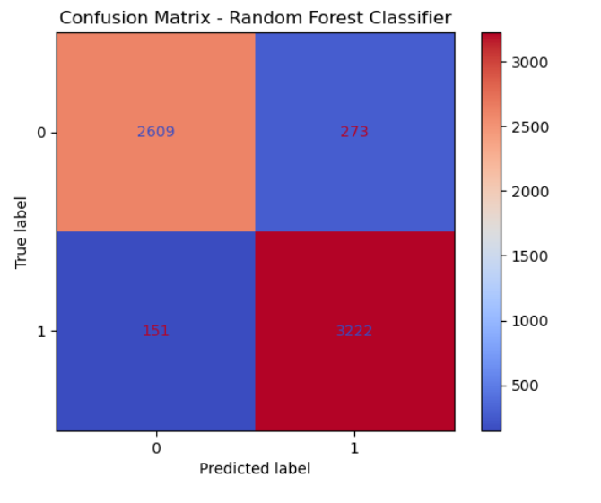
Confusion Matrix
The model shows high precision and recall for both classes. For low-risk customers (class 0), the precision is 0.95 and recall is 0.91, meaning that the model accurately predicts non-churners most of the time but misses a small portion.

Slide 15
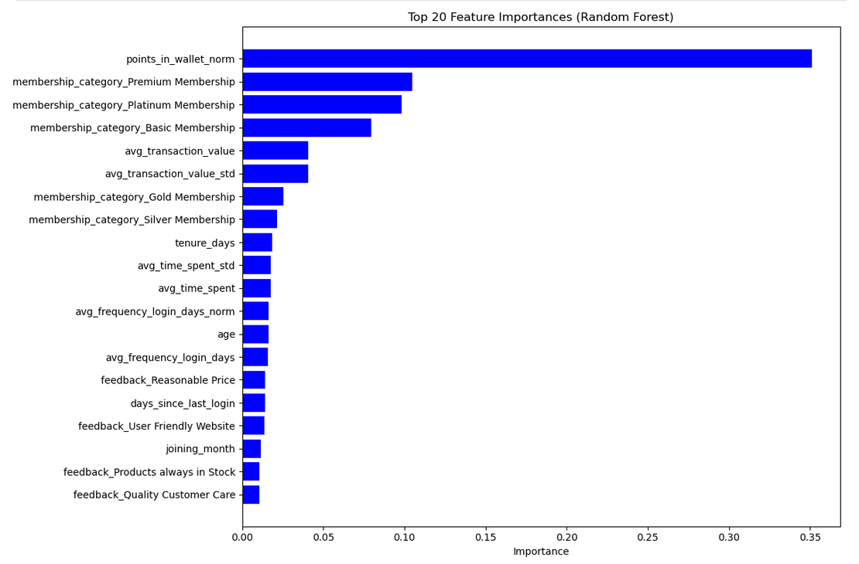
Which variables are the highest predictors of churn?

Slide 16
The feature with the highest importance by far is points in wallet (0.35), indicating that the number of points a customer has in their wallet plays a major role in determining churn risk. This suggests that customers with more loyalty or reward points are less likely to churn, possibly because they’re more engaged or have incentives to stay.
Next in line are membership categories, These indicate that membership level strongly influences churn behavior, with different tiers carrying different retention patterns.
Other transactional features like average transaction value and its standard deviation also show up as important (~0.04 each), meaning spending behavior has a solid link to churn likelihood. Similarly, Gold and Silver memberships contribute to the prediction, though with slightly less impact.

Slide 17
XG Boost Model
XGBoost (Extreme Gradient Boosting) is a machine learning algorithm based on the gradient boosting framework. It’s widely used for classification and regression tasks, especially in structured/tabular data.
Advantages
High Speed
High Accuracy
High scalability

Slide 18
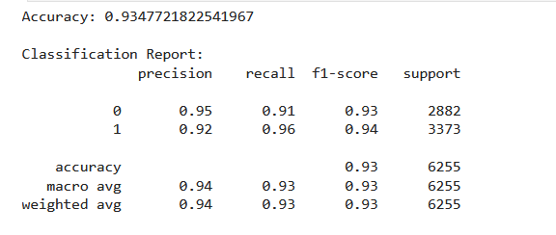
XG Boost Model
Model Results
The XGBoost model achieved an accuracy of 93.4%, indicating strong overall performance in predicting customer churn.

Slide 19
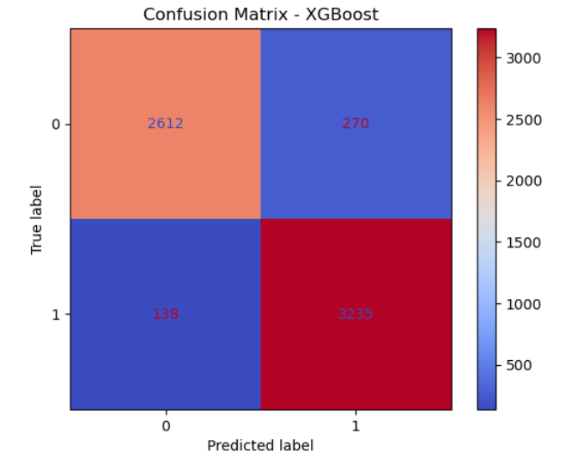
Confusion Matrix
This confusion matrix shows the model correctly predicted 2,626 non-churn cases and 3,216 churn cases, with 157 false positives and 257 false negatives. The higher true positive rate aligns with the classification report’s 95% recall for churn, indicating strong detection of at-risk customers.

Slide 20
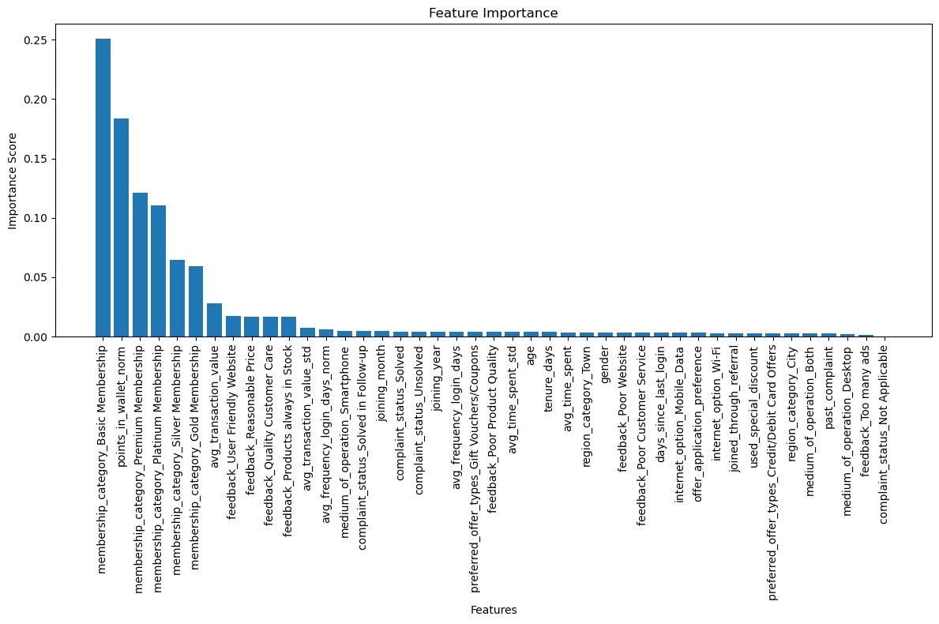

Slide 21
Xg-Boost Feature Importance analysis
It reveals that membership category (especially Basic and Premium) and points in wallet are the strongest predictors of churn, with high importance scores (0.125–0.075). Other influential factors include transaction value, customer feedback, and login behavior.
Operational factors like medium_of_operation_Smartphone and unresolved complaints also contribute, though with lower impact. This suggests that subscription tier, financial incentives, and service quality are key drivers of customer retention.

Slide 22
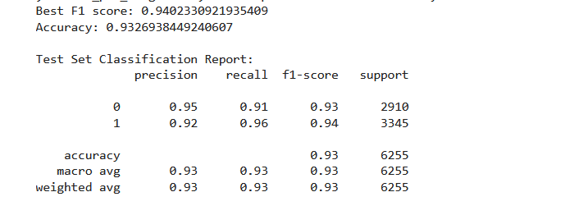
XG-Boost Model inculcating RandomizedSearchCV
Model Results
The tuned model performs nearly the same as the original one, with both achieving 93% accuracy and similar F1-scores.

Slide 23
Multilayer Perceptron Neural Network Model (MLP)
A Multilayer Perceptron (MLP) is a class of feedforward artificial neural network. It's one of the simplest and most widely used types of neural networks, especially for classification and regression tasks on structured/tabular data

Slide 24
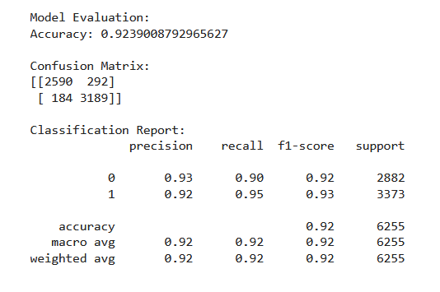
Model Output

Slide 25
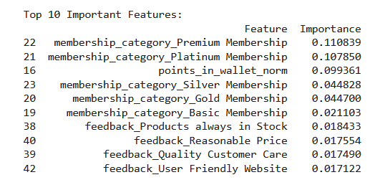
MLP Feature Importance Summary

Slide 26
Model Evaluation
Our objective was to build a supervised machine learning model capable of predicting customer churn risk for internet service providers using behavioral, transactional, and feedback data.
We managed to build models using ensemble methods and neural networks.
The best model was XG-Boost with 93% accuracy in predicting customer churn.

Slide 27
Model Deployment
The XGBoost selected as the best model was deployment through saving with joblib, and served through a Flask API.
The model is loaded into the app, which exposes a predict route that accepts JSON input and returns predictions.
This setup enables quick and efficient model deployment as a web service, testable via tools like Postman or curl.

Slide 28
Project Results Summary
Basic Membership holders have the highest likelihood of churning. As membership tiers increase (Silver, Gold, Premium, Platinum), the churn risk significantly drops. This points to membership level being a major driver of customer retention.
From a demographic perspective, customers living in City regions have the highest average churn risk, followed by Towns, with Villages having the lowest risk.
We found that just having a recorded complaint, regardless of whether it was resolved, is linked to higher churn risk.
Non-churning customers tend to cluster around wallet point values of 500–1000, suggesting that these thresholds might align with retention-boosting benefits

Slide 29
Recommendations to ISPs
Encourage membership upgrades by offering exclusive perks or discounts for higher-tier plans.
Improve the complaint resolution experience through fast resolution and follow up to enhance customer satisfaction
Introduce incentives such as tiered rewards, point boosters, and milestone badges to increase wallet point engagement.
Use churn-risk predictions to trigger targeted ad campaigns such as special offers, call-backs, or targeted emails.
Focus retention efforts in city and town regions where churn risk is higher, possibly with local partnerships or targeted discounts.

Slide 30
End of Presentation
Thank You

Slide 31
Presentation Prepared by:
Group 9 Members;
Jane Bahati
Wambui Kariuki
Japhet Cheboiywo
Gladys Njeri
Humphrey Matagaro
Brenda Kurgat

